Slide 1
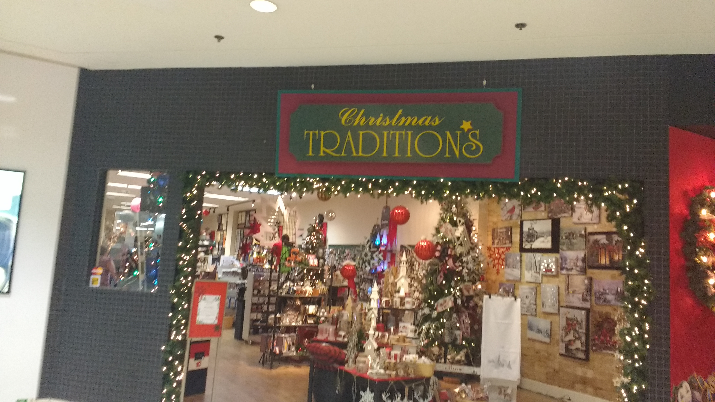
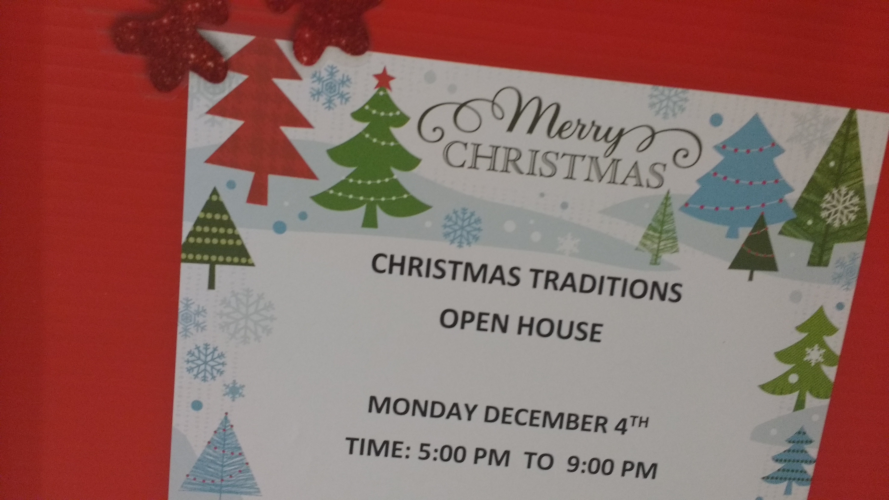
Question #1: Merry Christmas
Christmas Company
Focusing around Christmas, not other holidays
Holiday Wording:
They try to appeal to everyone instead of just one religion/tradition

Slide 2
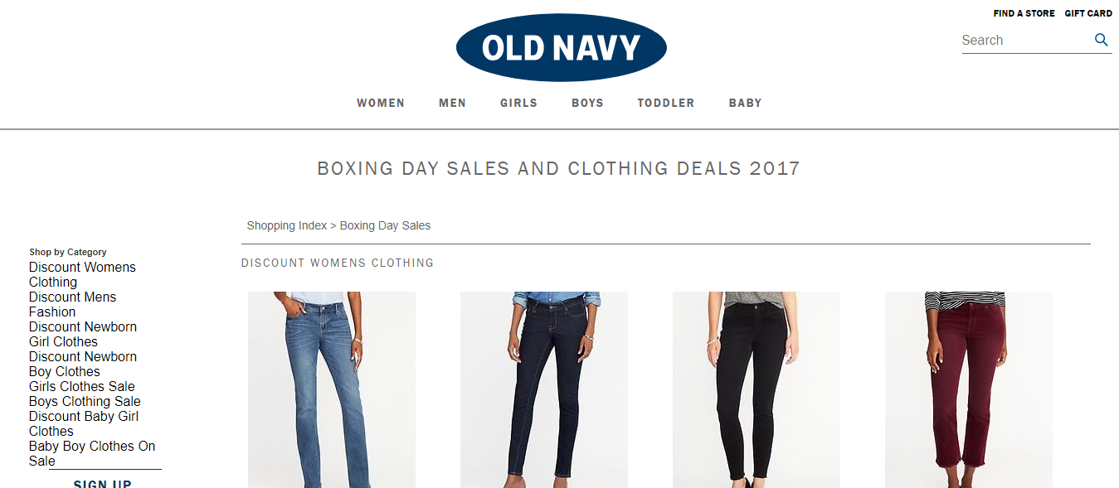
Question #2: Boxing Day
Couldn’t find any boxing day sales, except for the store’s website

Slide 3
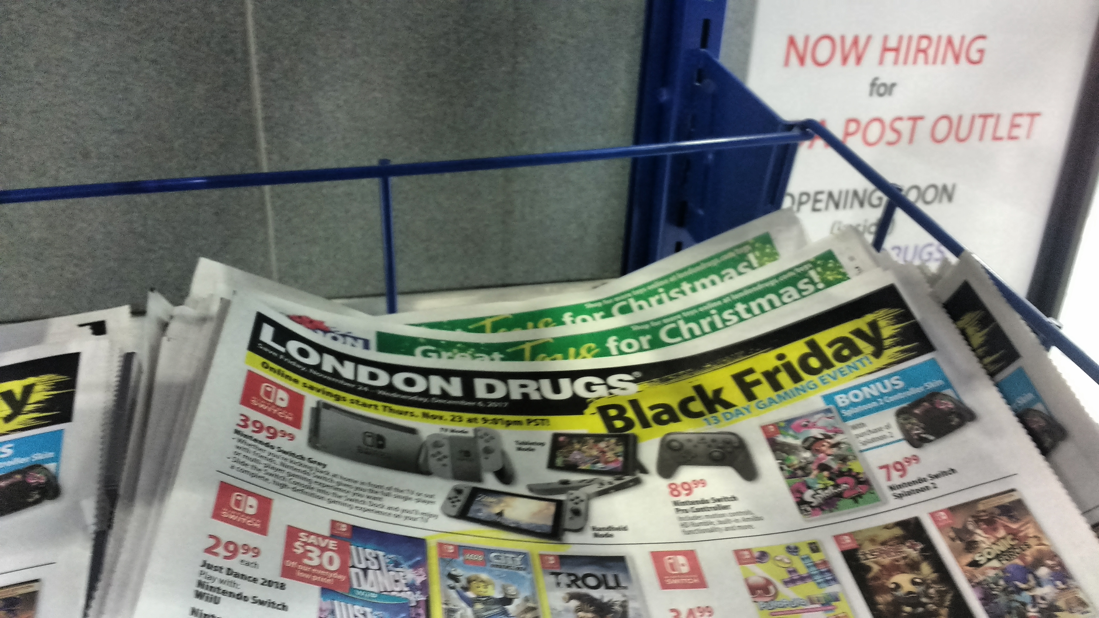
Question #3: Black Friday
Only store that promotes Black Friday still
13 day gaming event
Prices are a bit lower than average

Slide 4
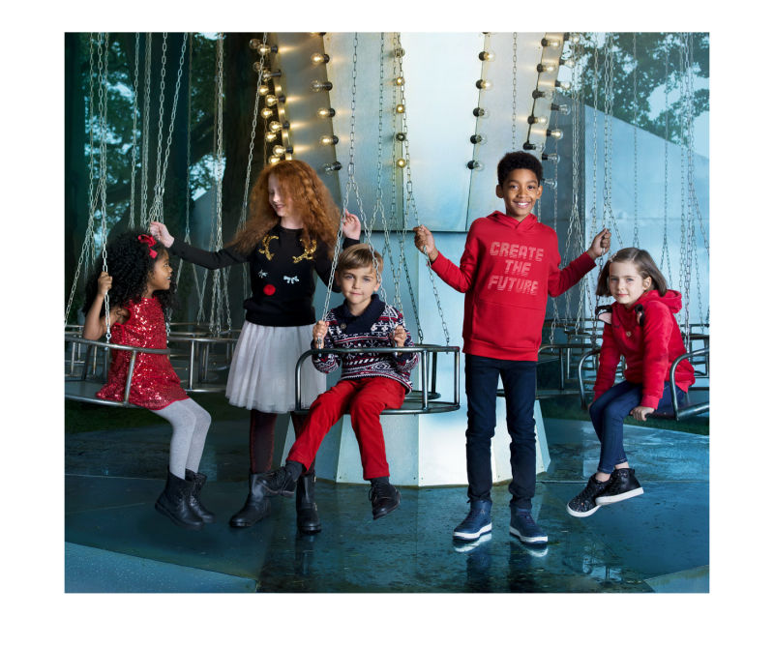
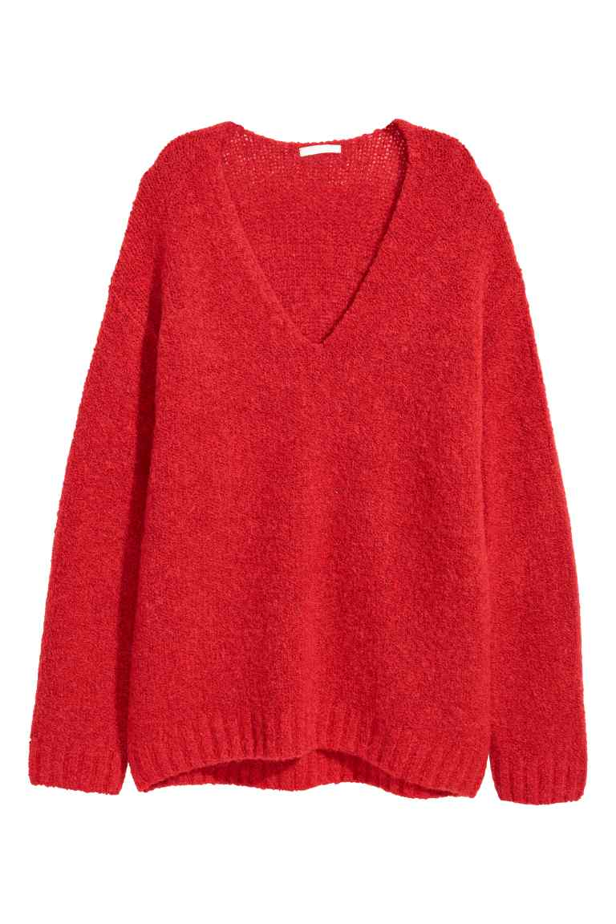
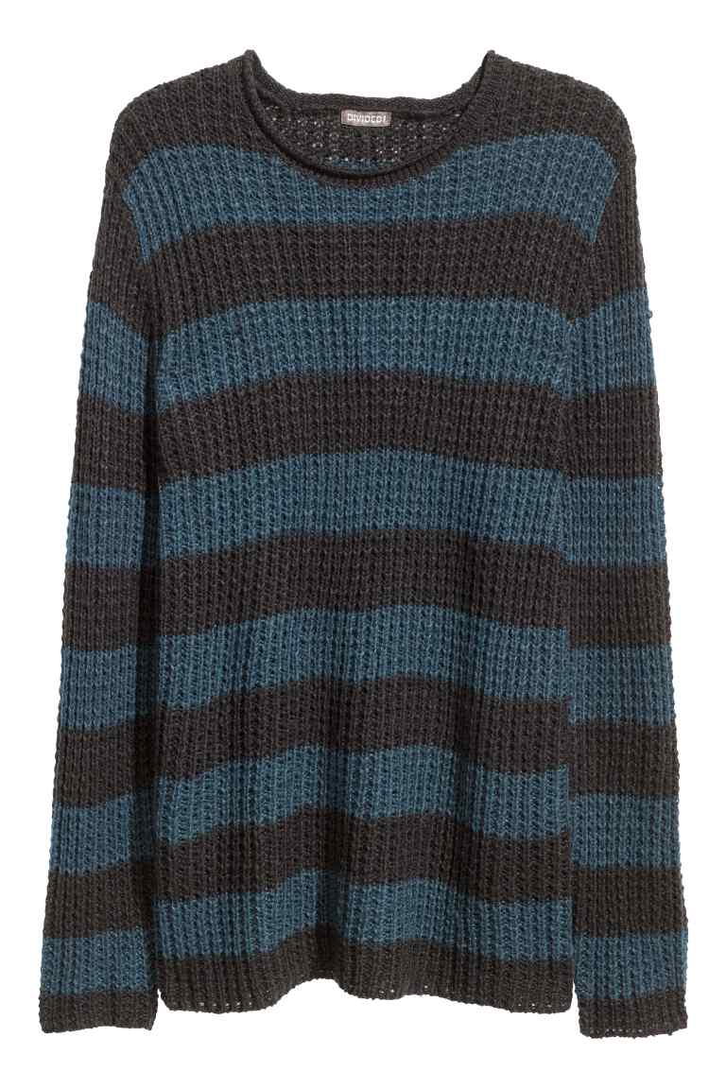
Question #4: Holiday Trends
Women and girls: Red sweaters and lightly colored dresses
Men and boys: Black and blue sweaters and jeans
Teens: Nothing

Slide 5
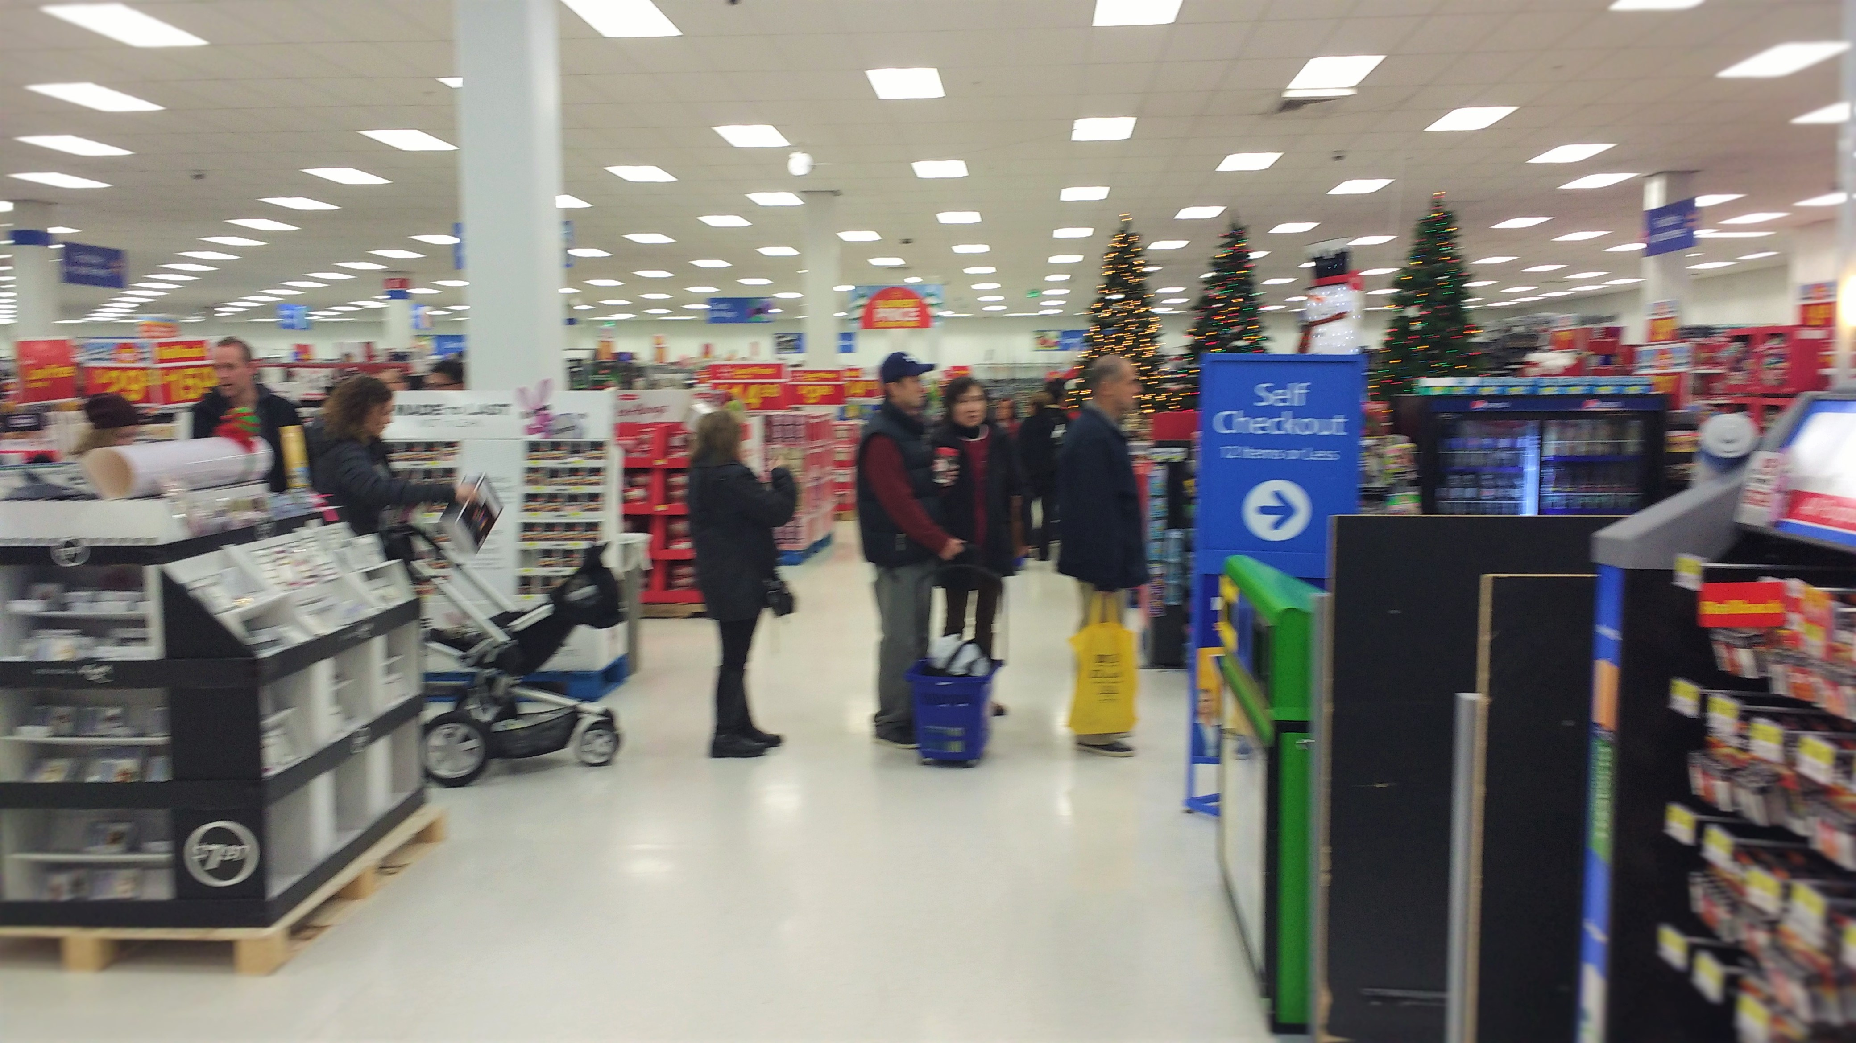
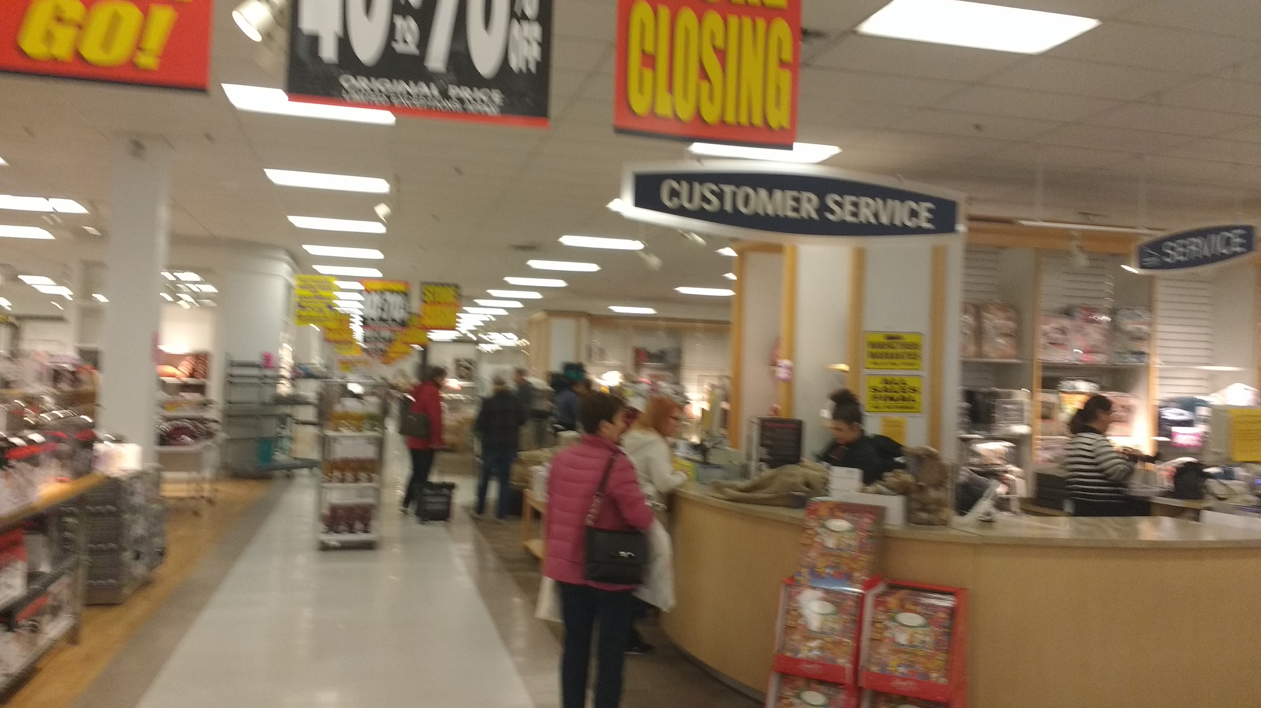
Question #5: Busiest Shops?
Walmart: It’s always busy because it’s popular
Sears: Stores closing
Massive discounts=More people willing to shop

Slide 6
Question #6: Target Market
Seniors and parents with babies because they aren’t at work
Mainly teens
Many stores geared toward teens

Slide 7
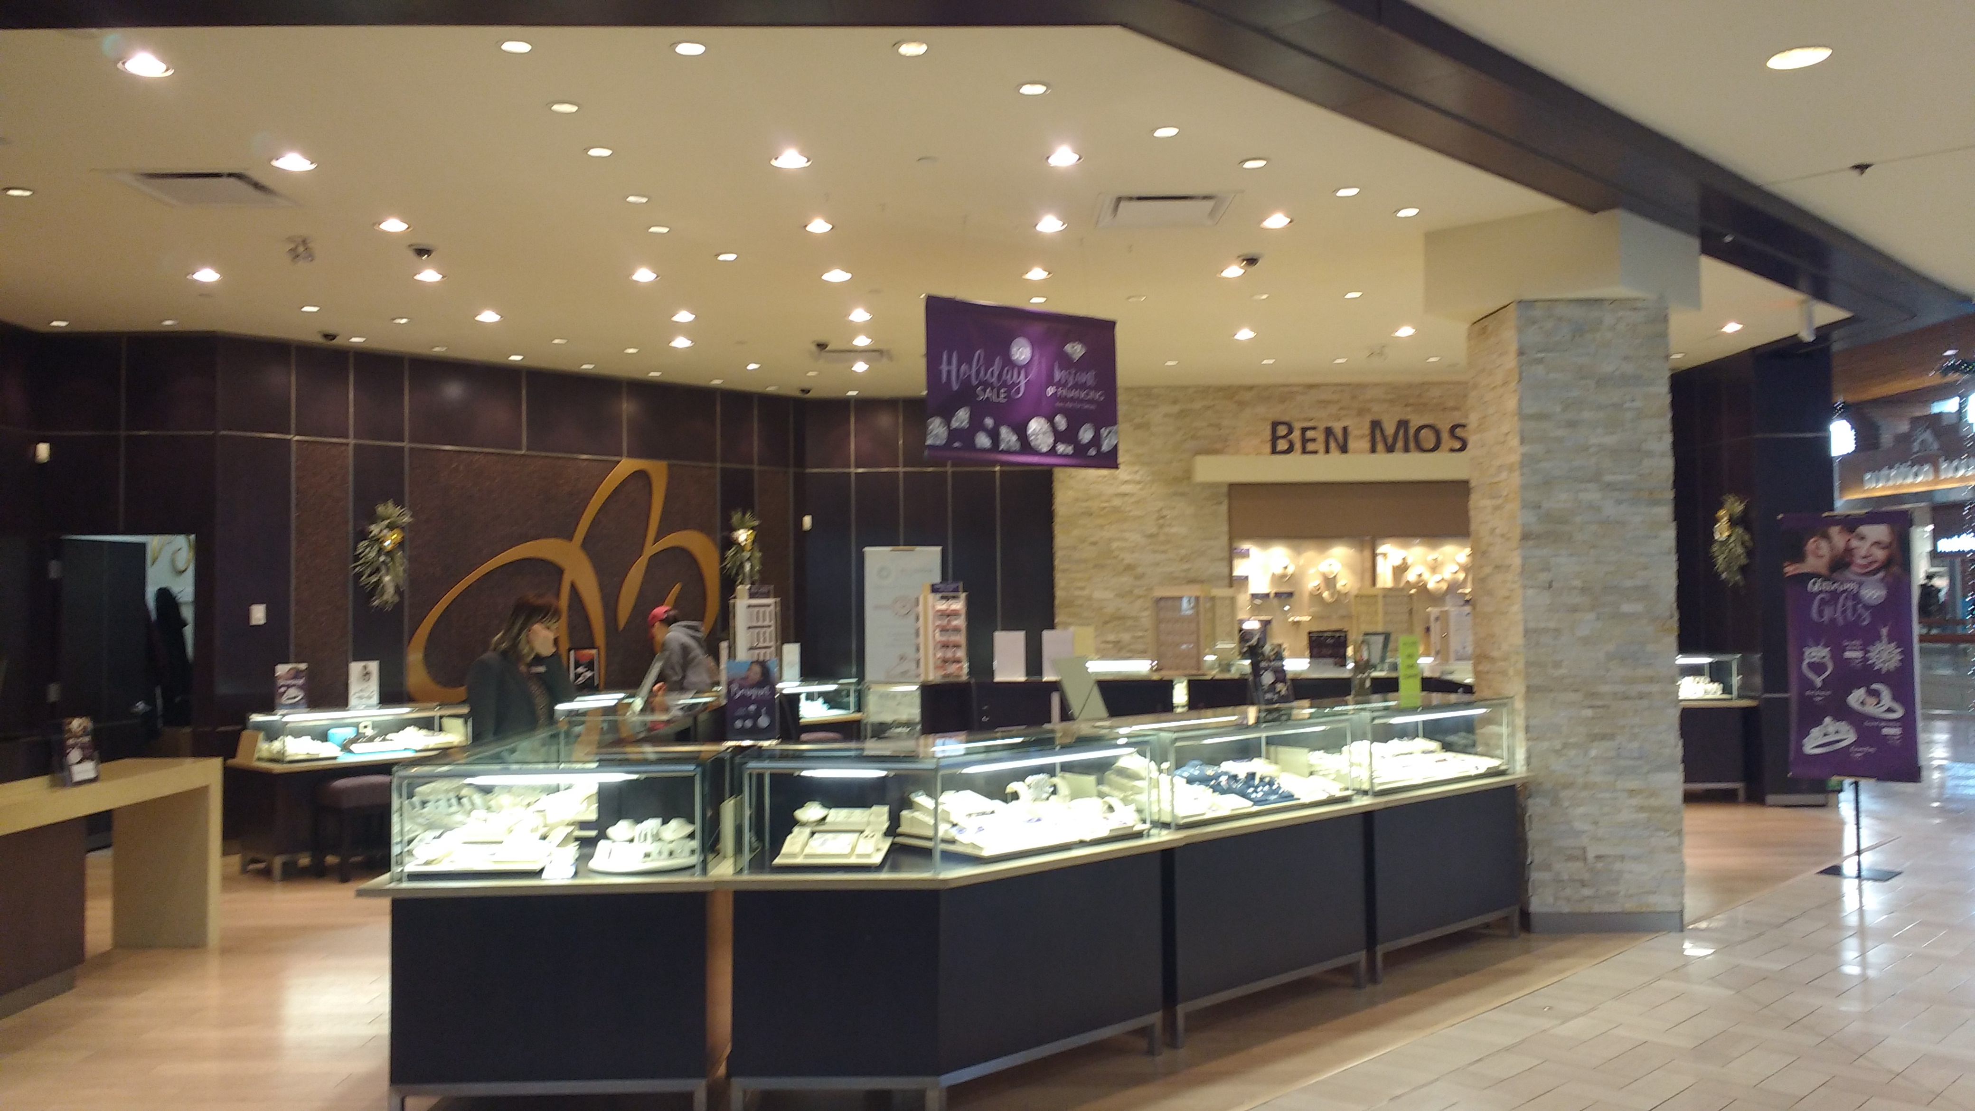
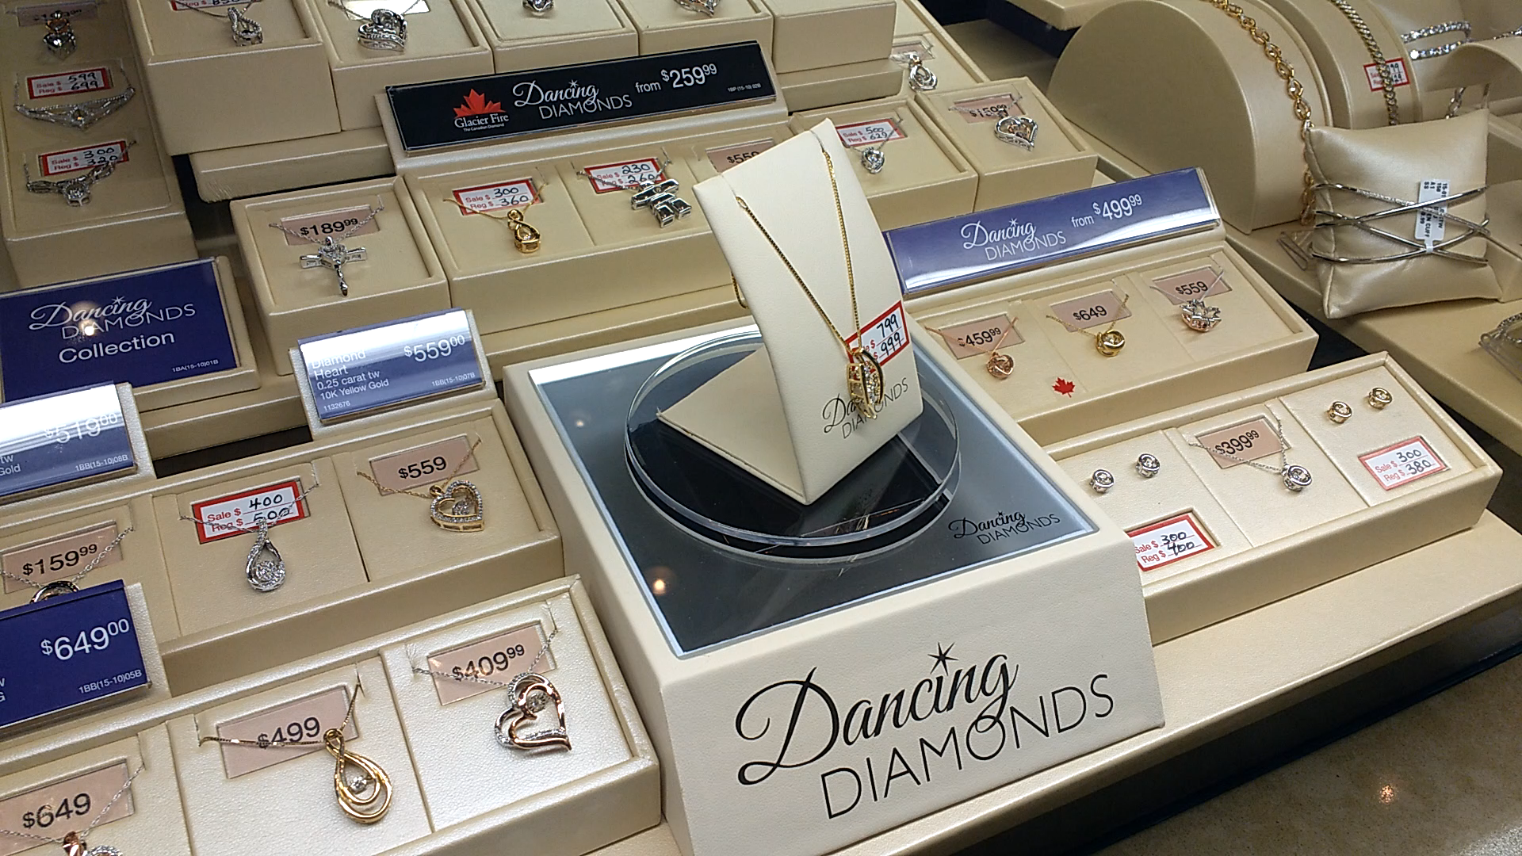
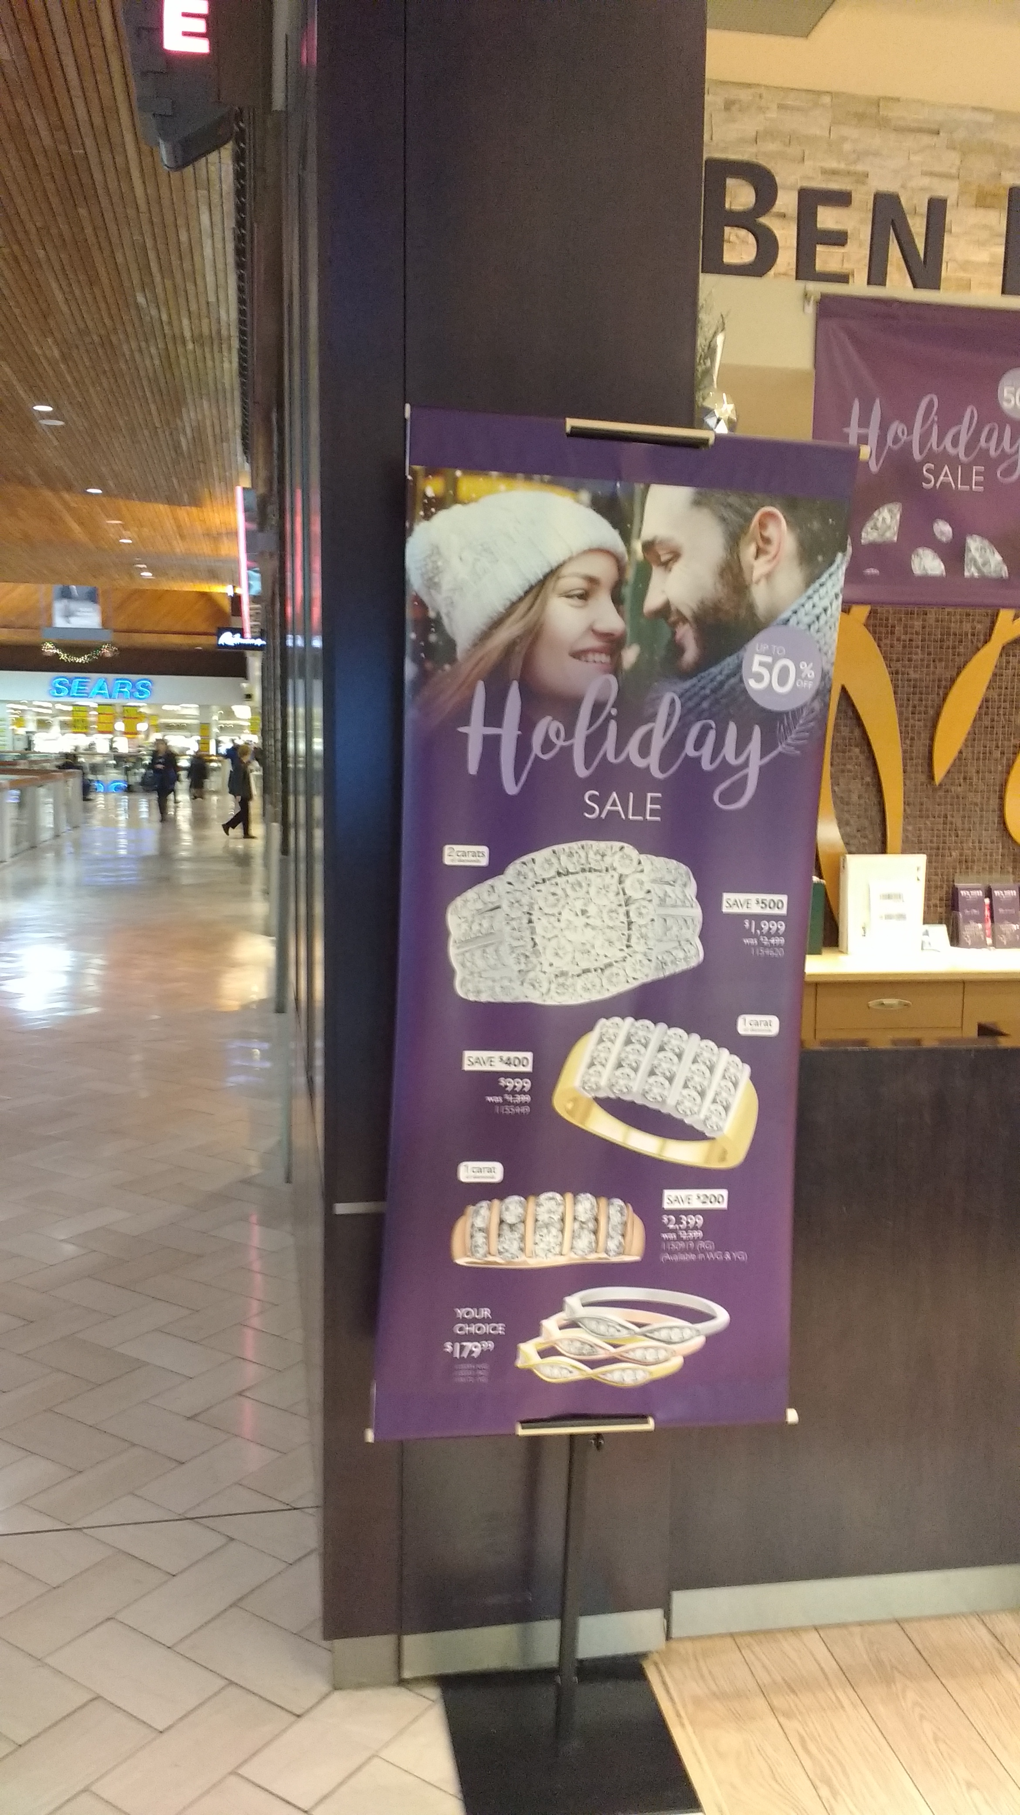
Question #7: Nicest Displays
Jewelry & specialty stores (eg. Ben Moss)
Since the presentation is most likely expensive, the product need to be also
Example of 4 P’s: Ben Moss:
Product: A specialty product
Place: Great location in a busy
area
Promotion: Major discounts
Price: Very expensive

Slide 8
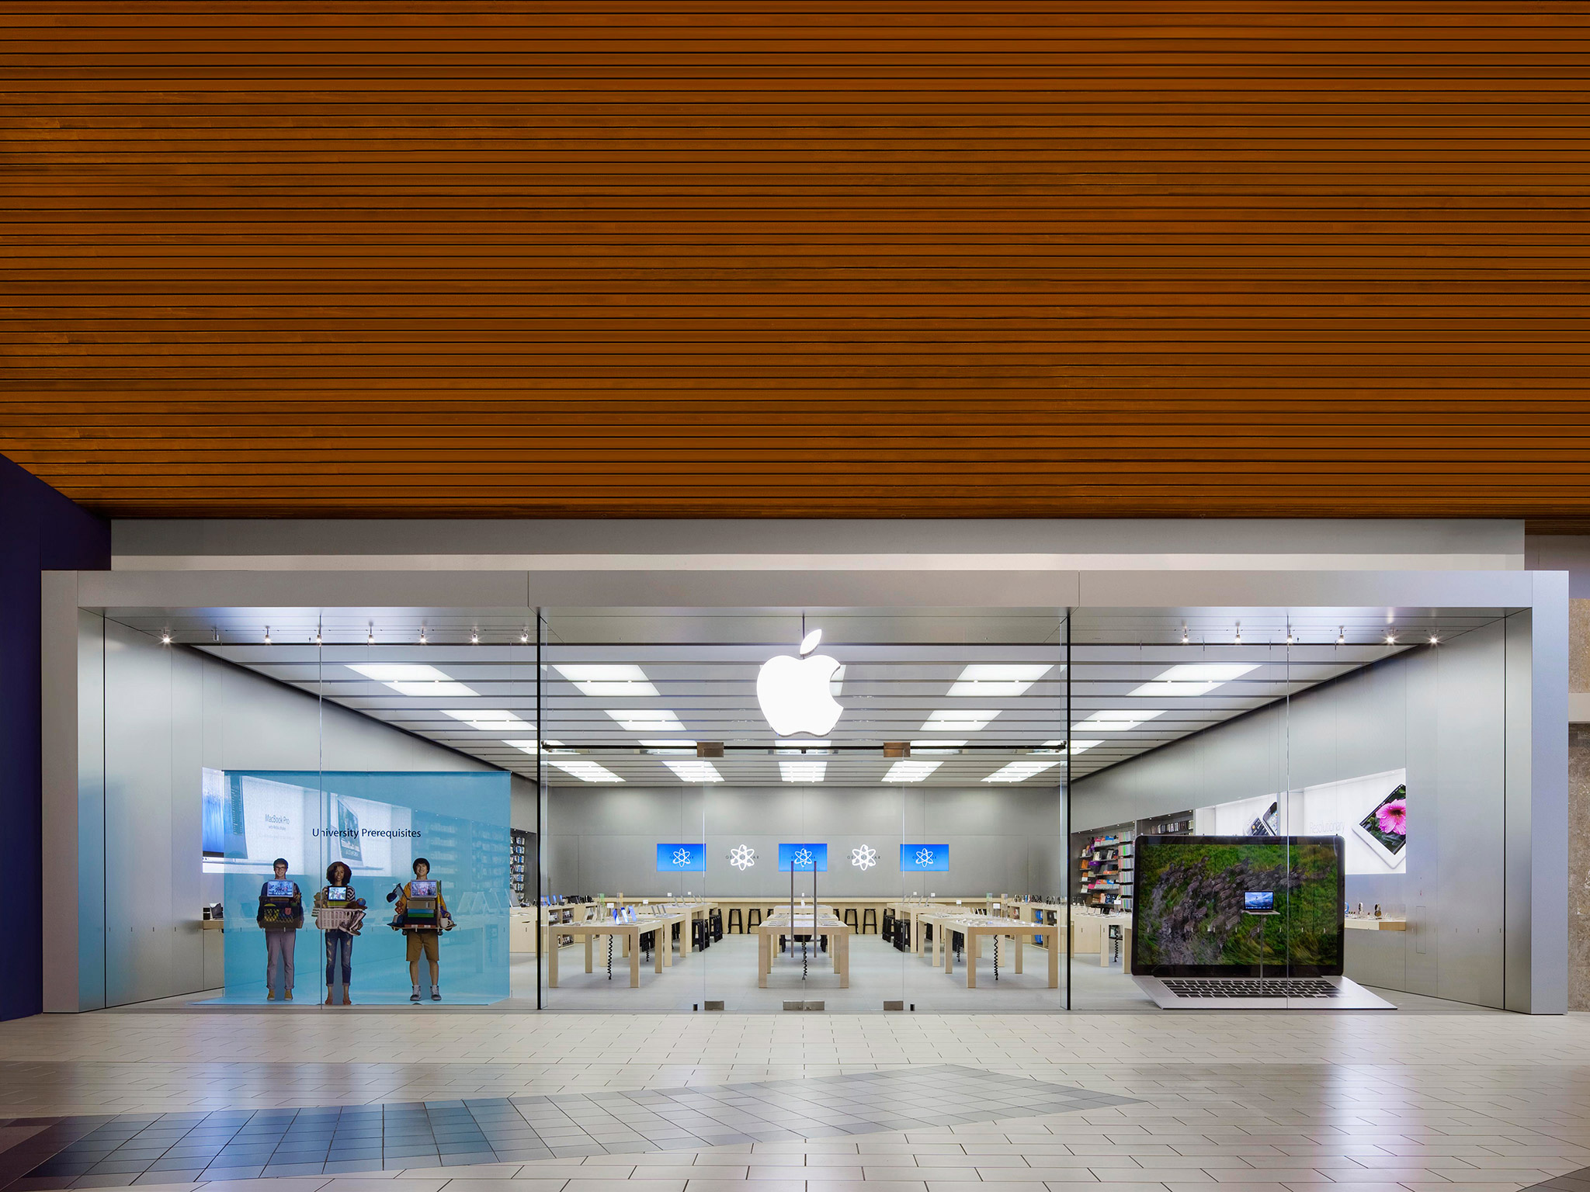
Question #8: Nice ‘Place’
Very unique
In a popular area
Very open design and clean
Very big and bold

Slide 9
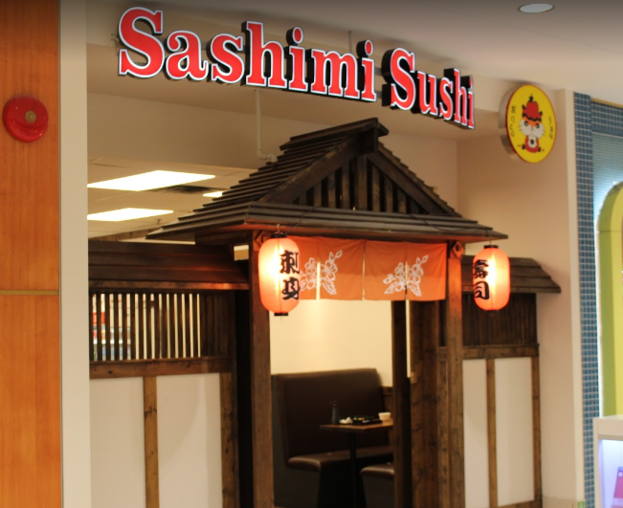
Question #9: Poor ‘Place’
In a very secluded location where no one goes
Across the mall from the food court
Next to very different stores

Slide 10
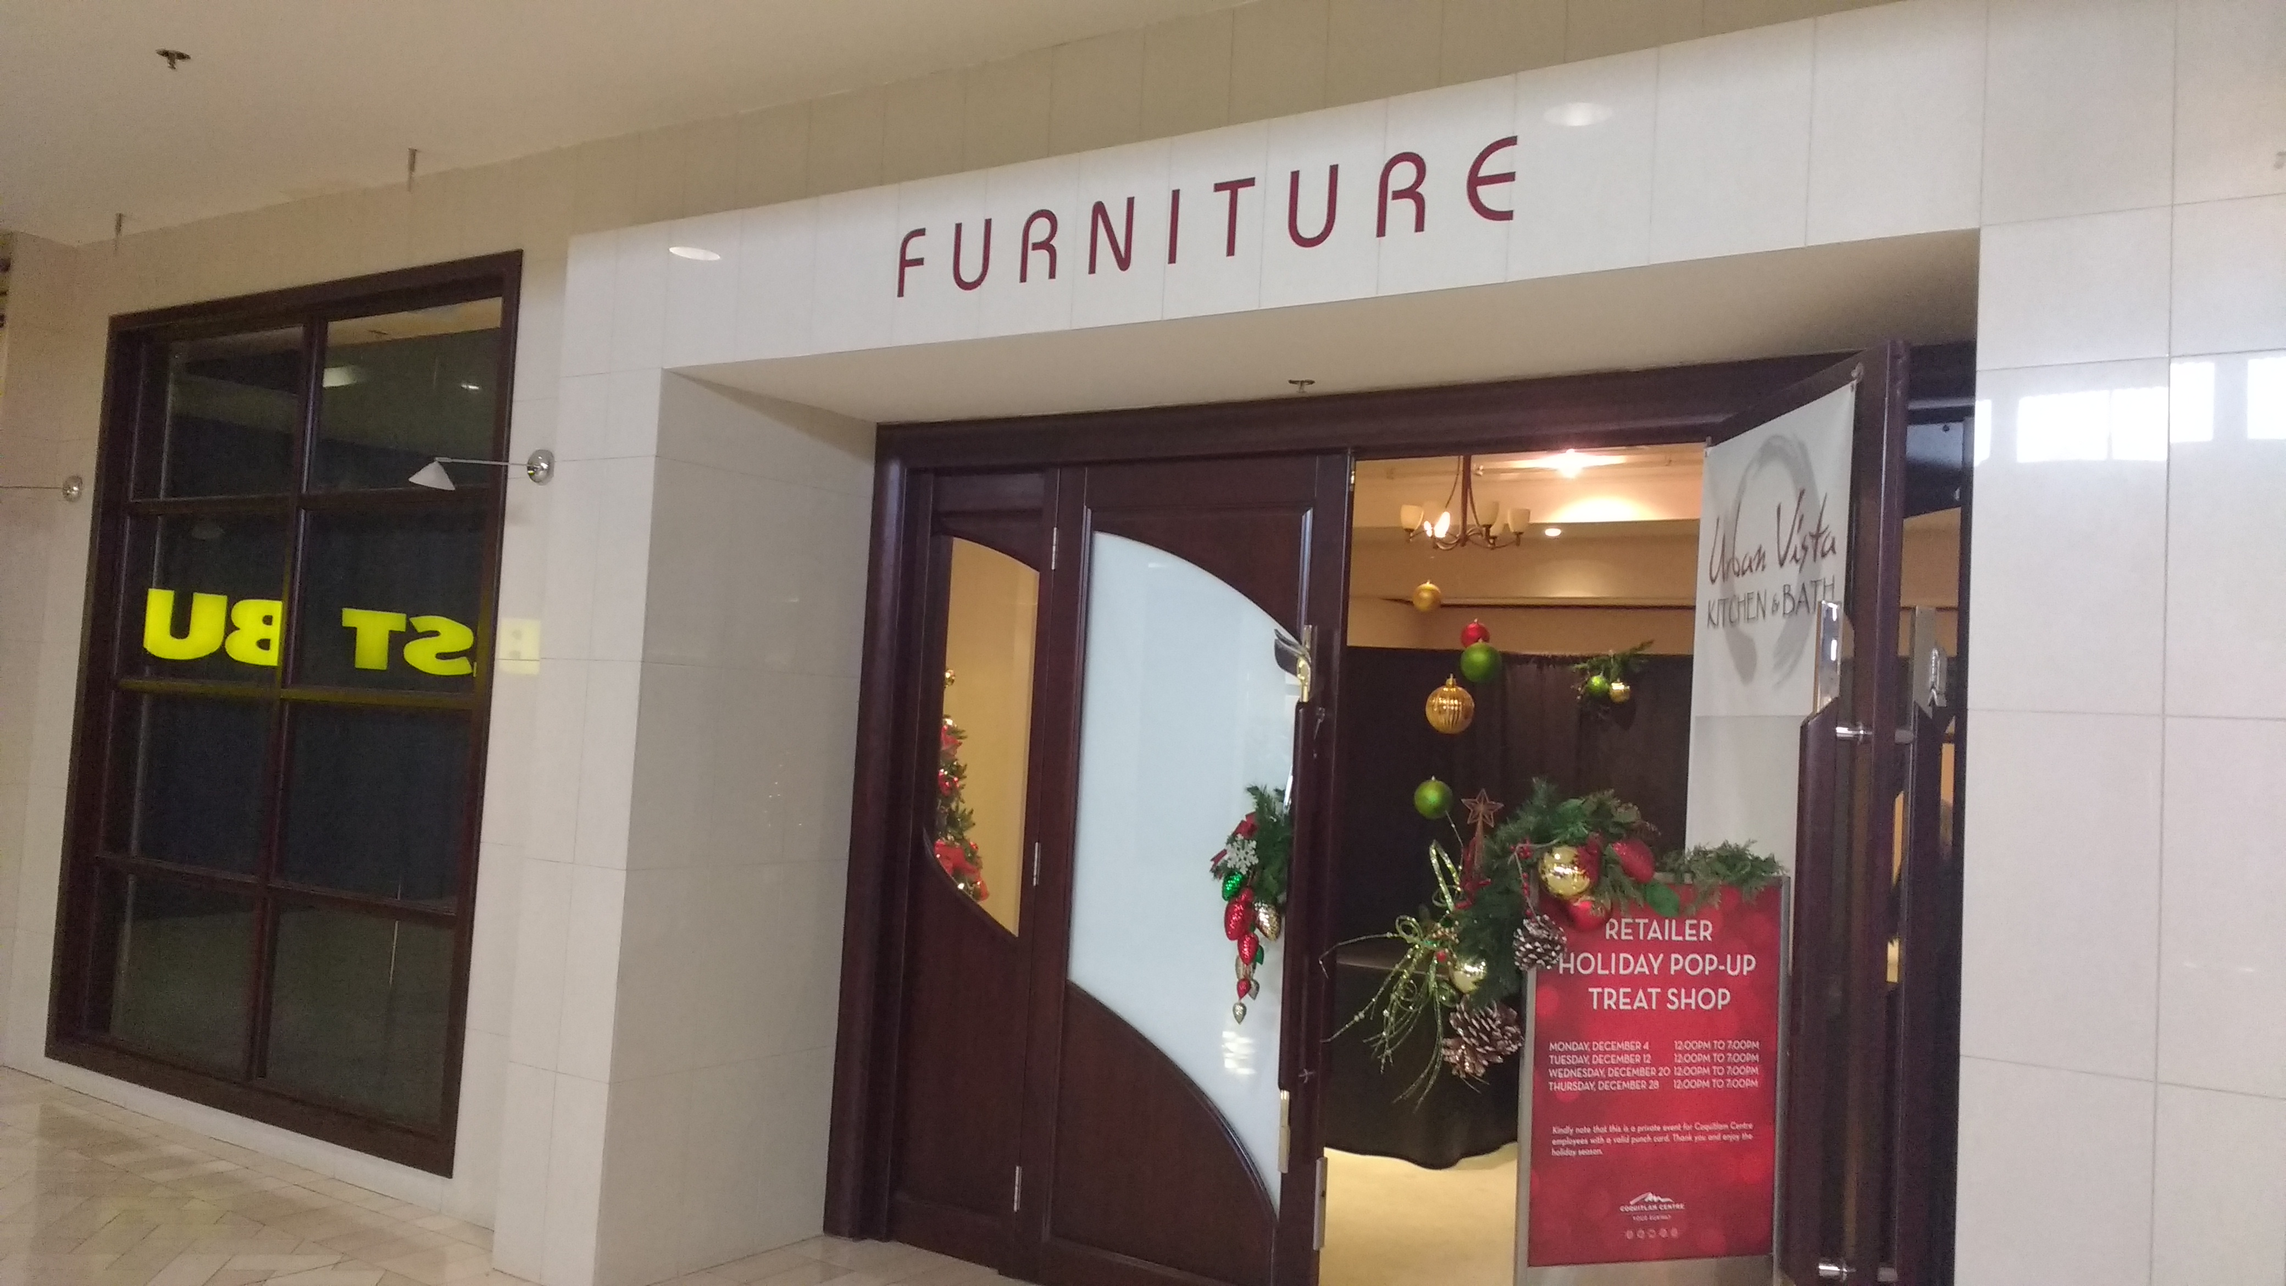
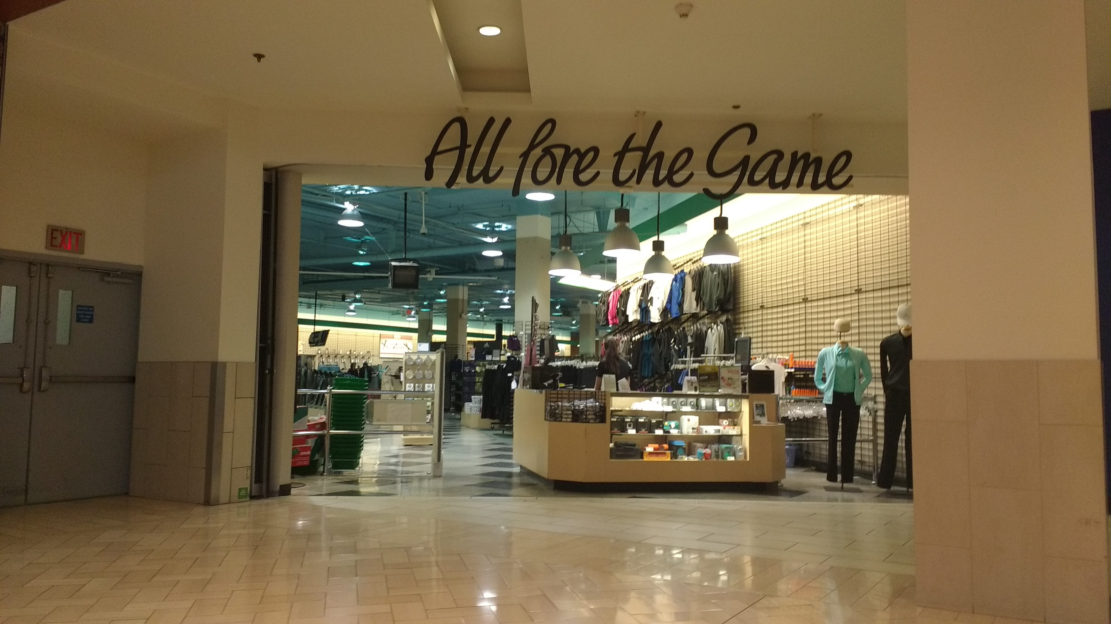
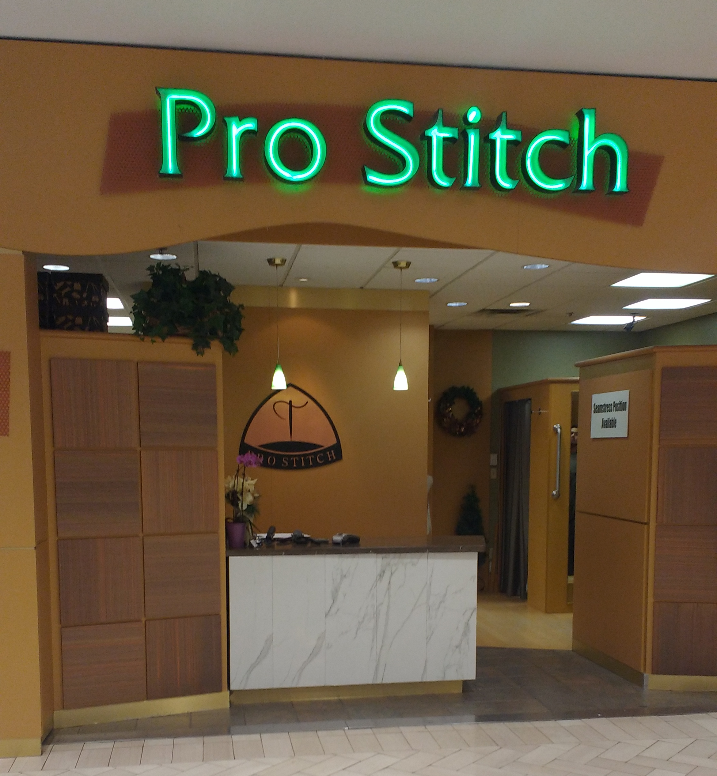
Question #10: Empty Stores
Furniture store?
Golf Town
Everyone is at work
Not in season
Pro Stich

Slide 11
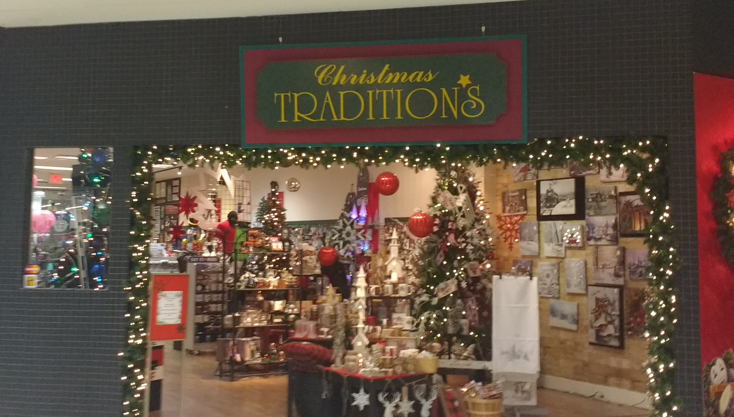
Question #11: Temporary Stores
Furniture store
Doubt they would make any sales
Christmas Tradition
Only at Christmas time!

Slide 12

Question #12: Profitable Store in Mall
Winners: Low prices and more popular than Sears
Microsoft: An Apple competitor and is doing good in other malls in Vancouver (eg. Metrotown)

